Slide 1

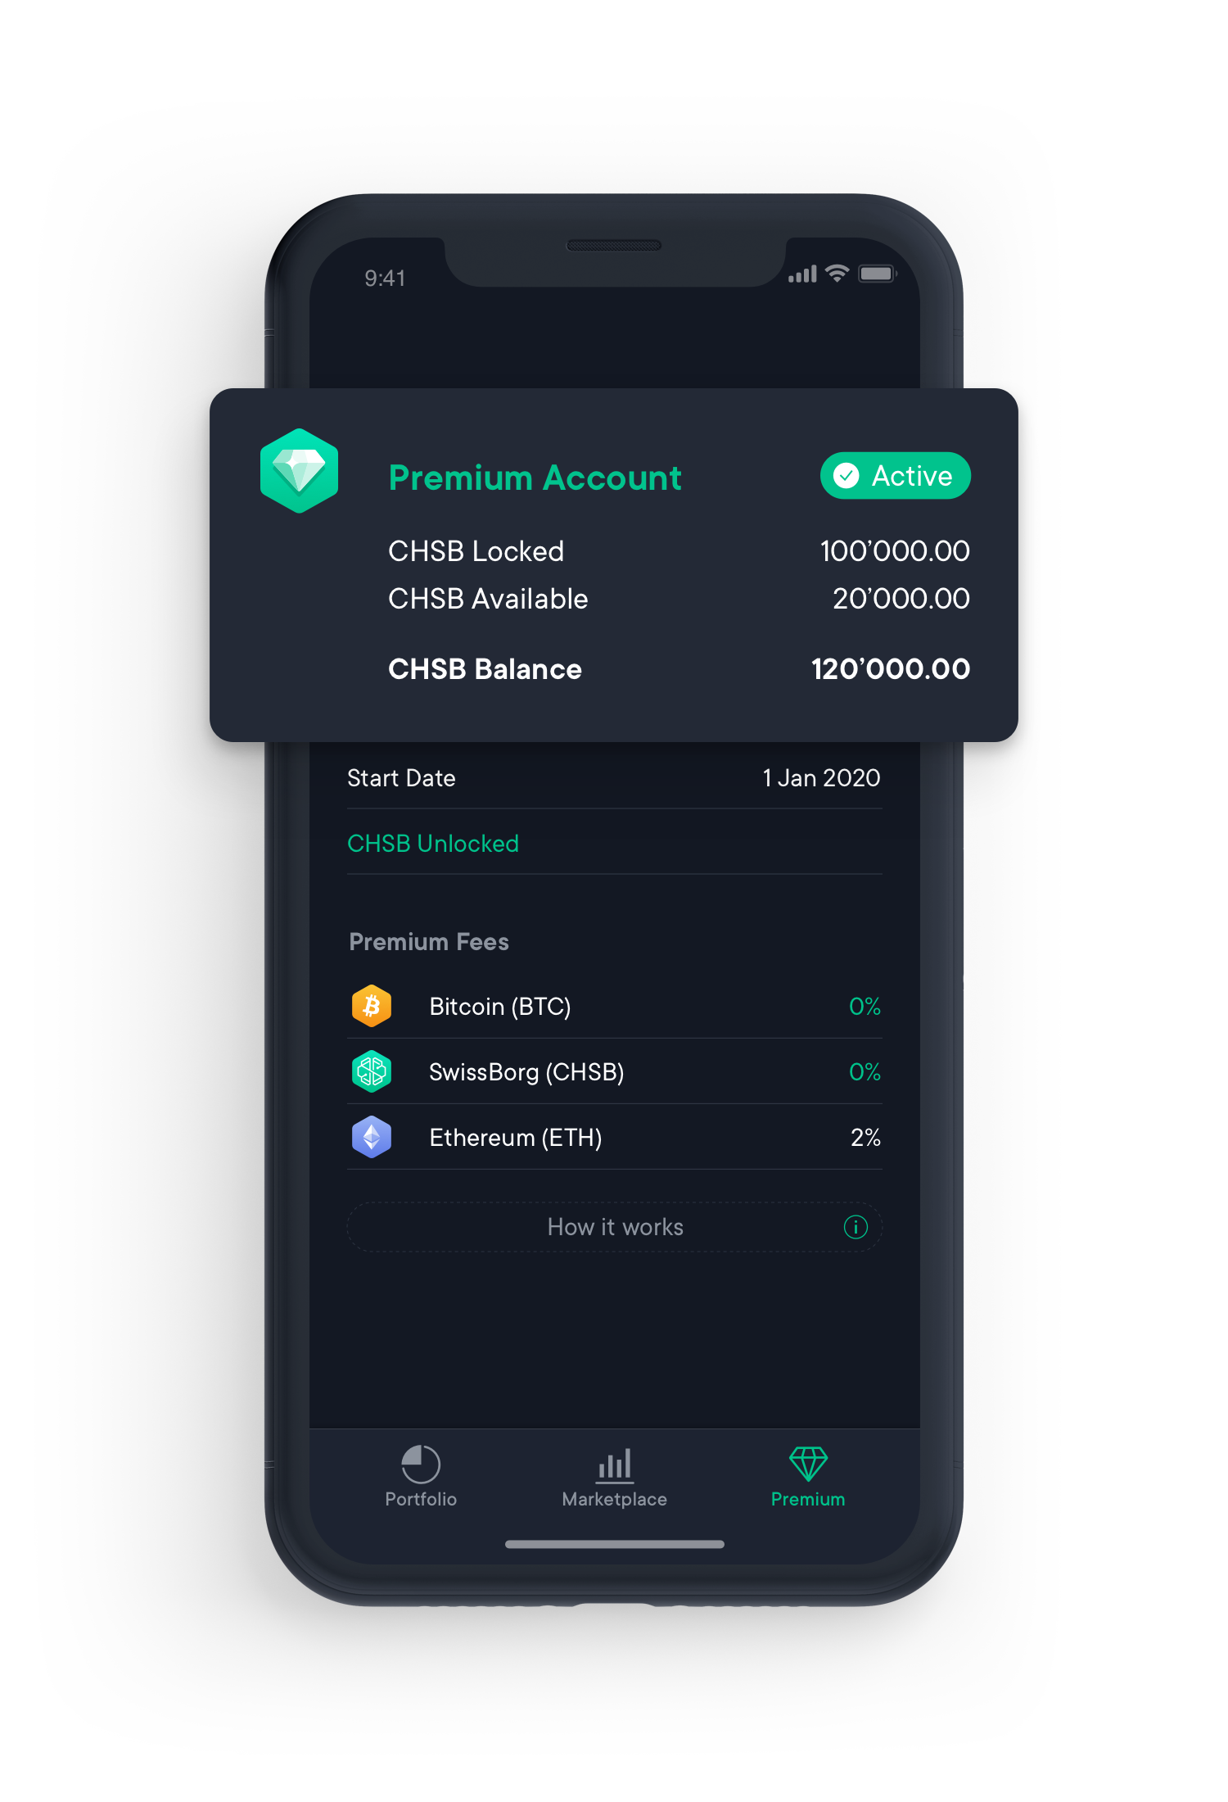
DATA ANALYST Tech Challenger
Anderson Cruz
28.10.2022

Slide 2

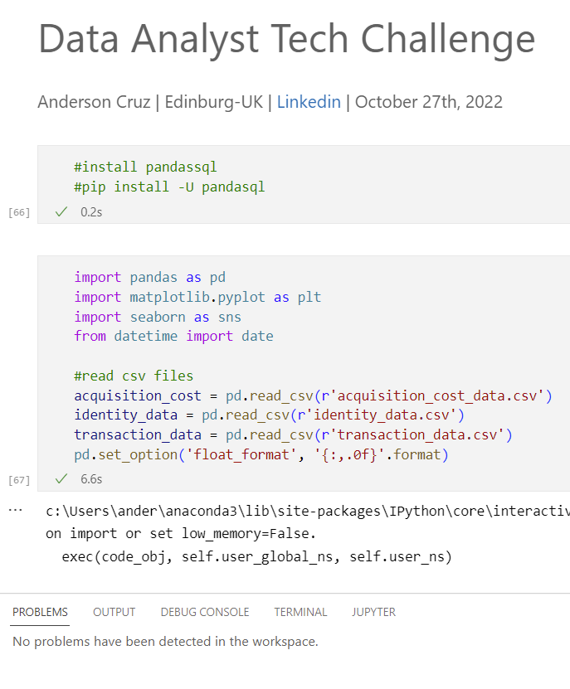



SWISSBORG – DATA ANALYST
RESOURCES
Google Drive: Link
Visual Studio: Link
Power BI: Link

Slide 3
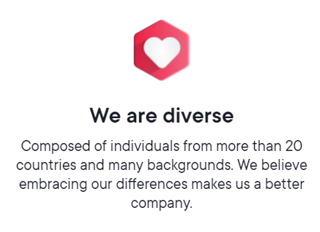
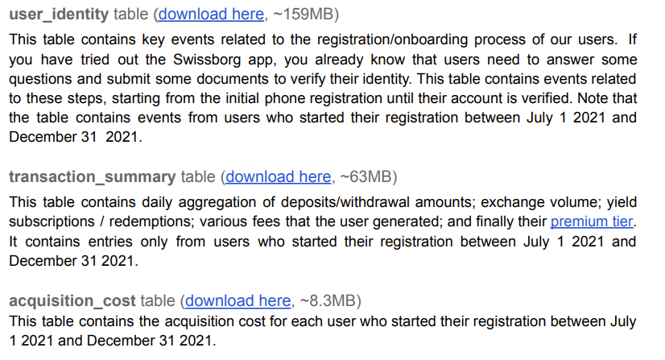

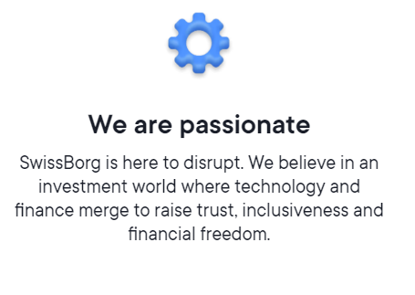
SWISSBORG – DATA ANALYST
DATASETS

Slide 4
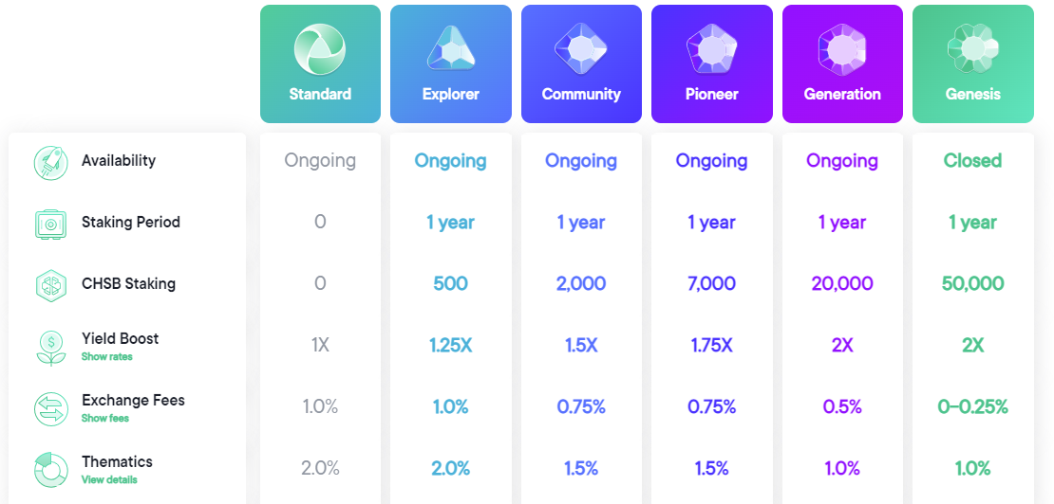
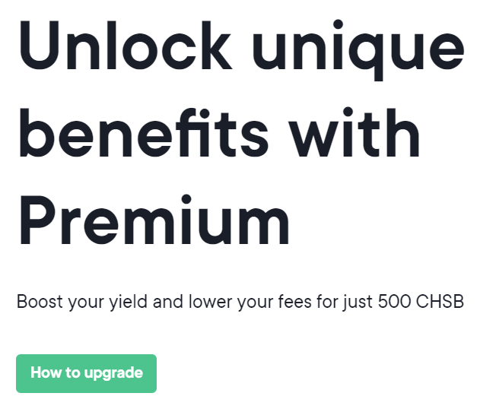

SWISSBORG – DATA ANALYST
PREMIUM TIER

Slide 5
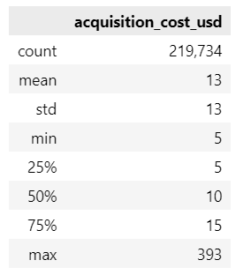
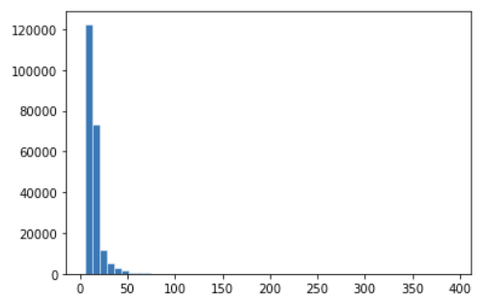
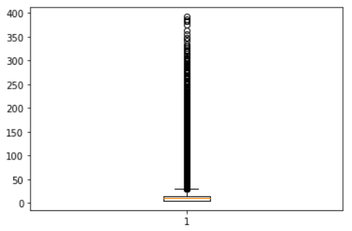
SWISSBORG – DATA ANALYST
ACQUISITION COST DATA
Total Users H2 2021: 219.734
Concetrated between 5 – 15
Few outliers from 15 - 393

Slide 6
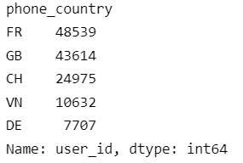
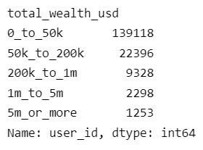
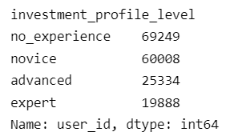
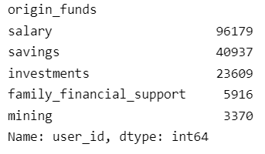
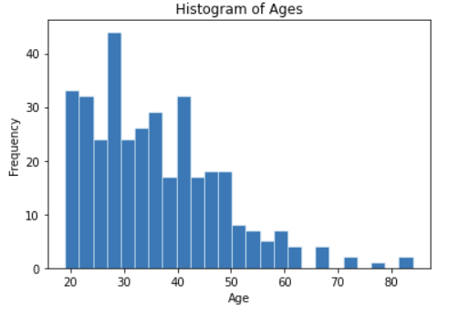
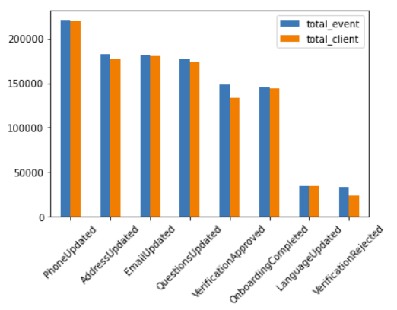
SWISSBORG – DATA ANALYST
IDENTITY DATA
Total Users H2 2021: 219.734

Slide 7
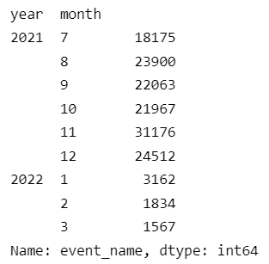
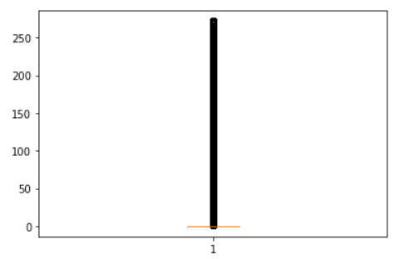
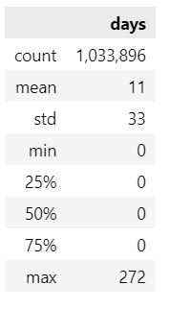
SWISSBORG – DATA ANALYST
IDENTITY DATA
Verification Approved
Days between Phone and Approved

Slide 8
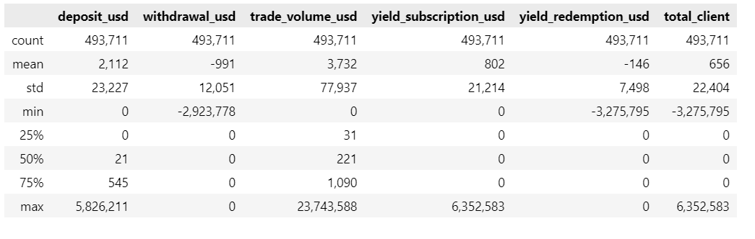
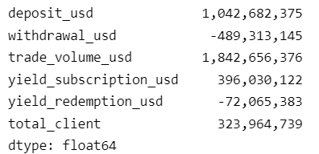
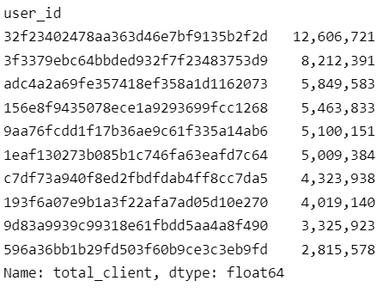
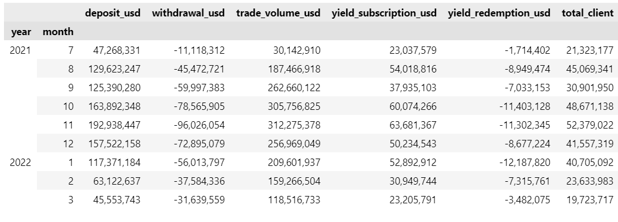
SWISSBORG – DATA ANALYST
TRANSACTION DATA - CLIENT
SUM()

Slide 9
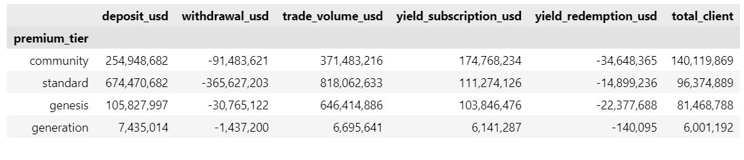
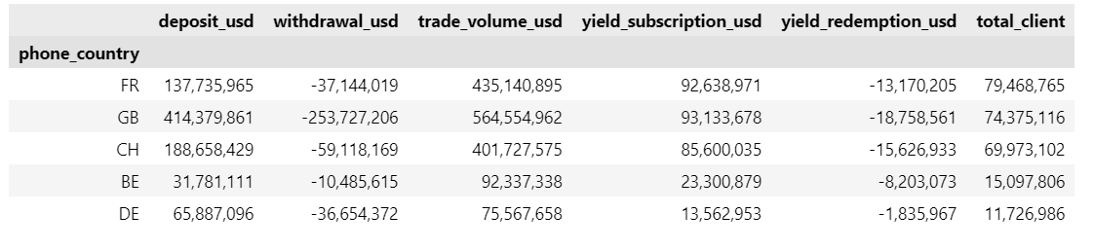
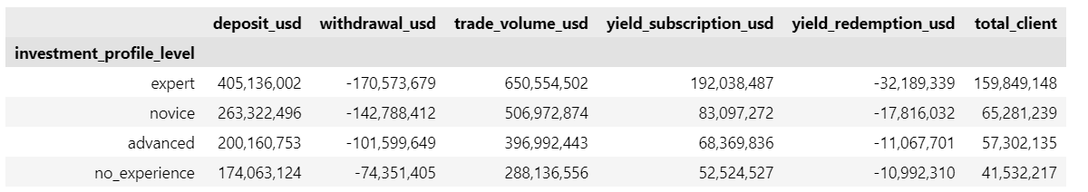
SWISSBORG – DATA ANALYST
TRANSACTION DATA

Slide 10
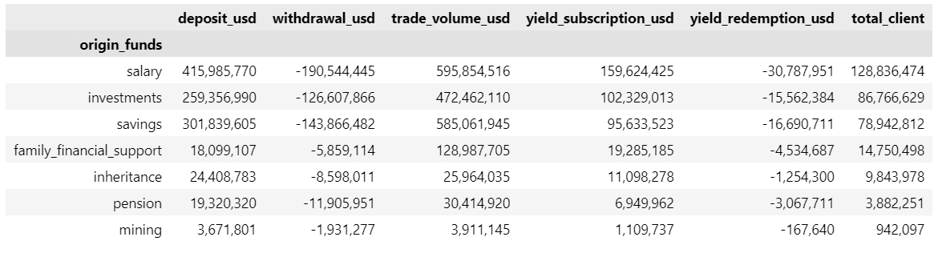
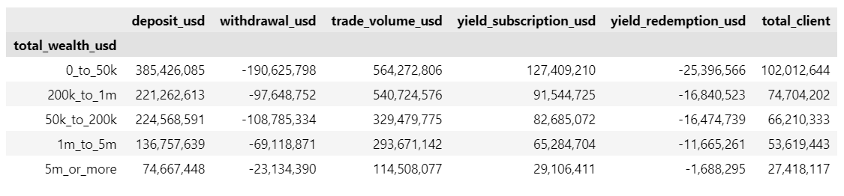
SWISSBORG – DATA ANALYST
TRANSACTION DATA

Slide 11
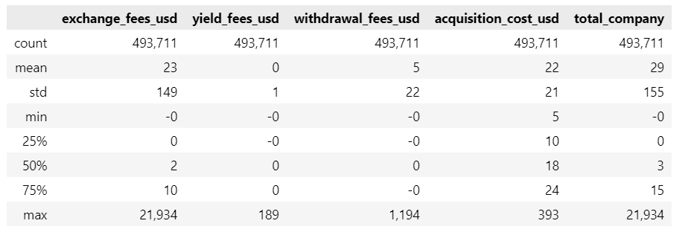
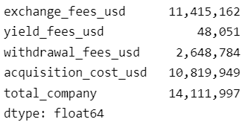
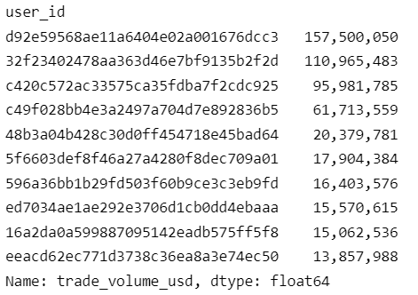
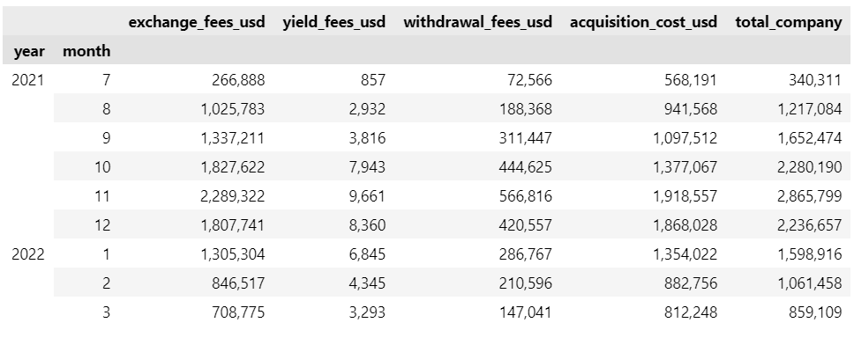
SWISSBORG – DATA ANALYST
TRANSACTION DATA - SWISSBORG

Slide 12
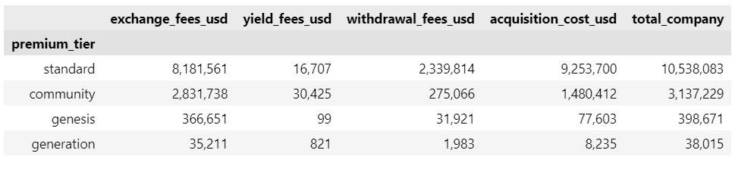
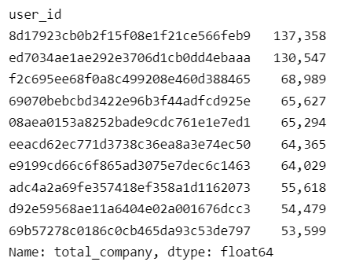
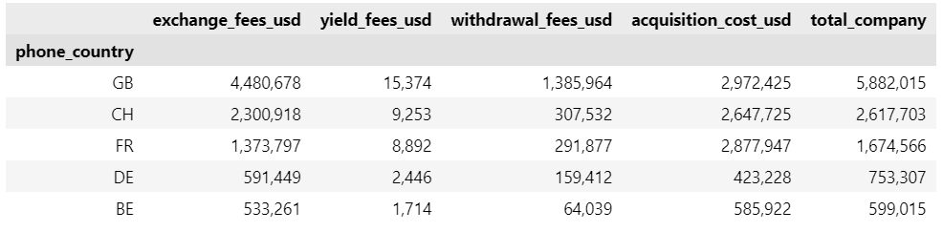
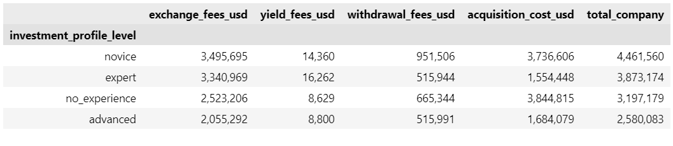
SWISSBORG – DATA ANALYST
TRANSACTION DATA - SWISSBORG

Slide 13
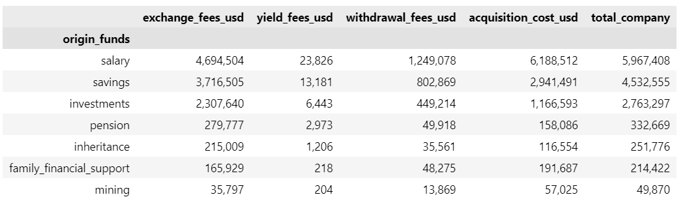
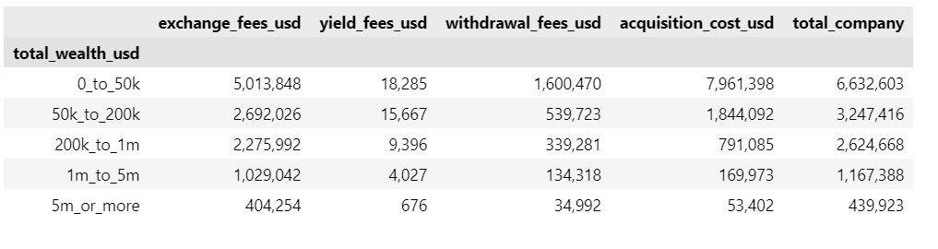
SWISSBORG – DATA ANALYST
TRANSACTION DATA - SWISSBORG

Slide 14
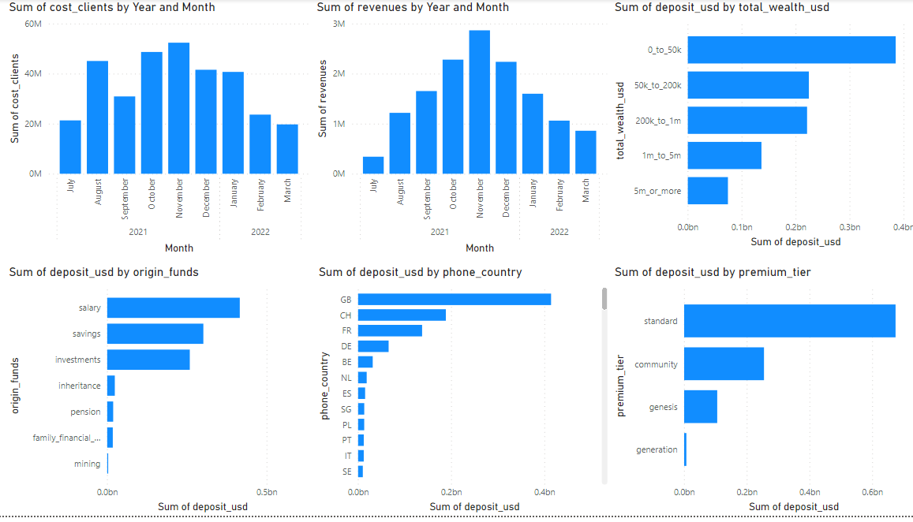
SWISSBORG – DATA ANALYST
TRANSACTION DATA - DEPOSIT

Slide 15
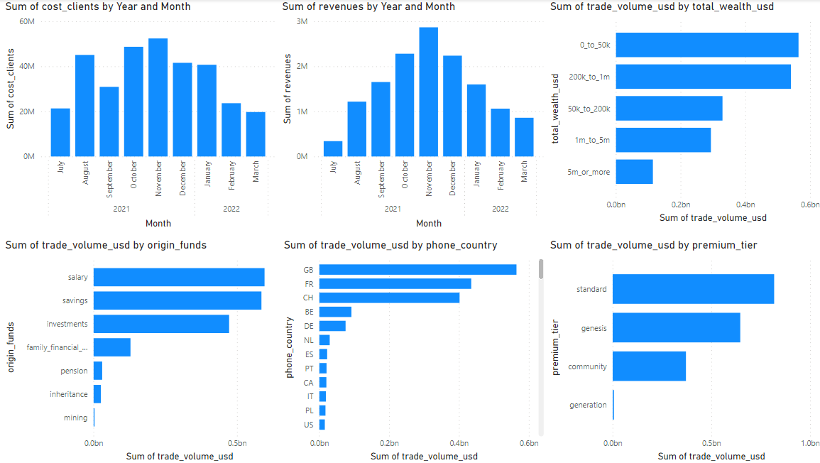
SWISSBORG – DATA ANALYST
TRANSACTION DATA - TRADE VOLUME

Slide 16
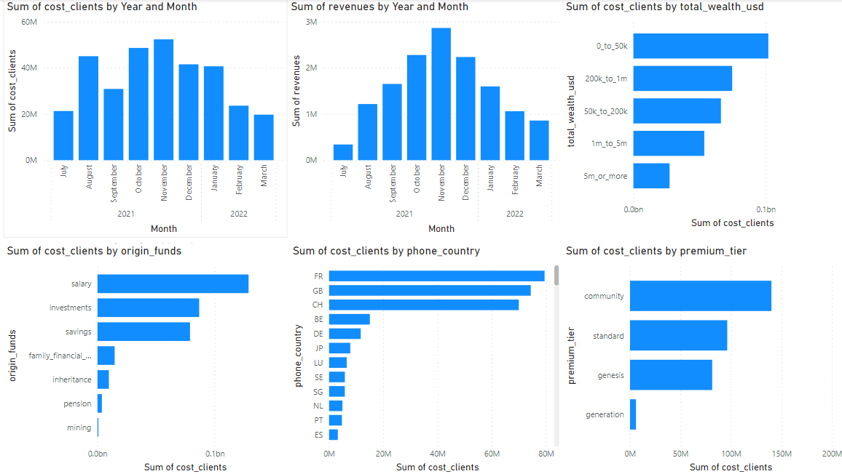
SWISSBORG – DATA ANALYST
TRANSACTION DATA – COST OF CLIENTS

Slide 17
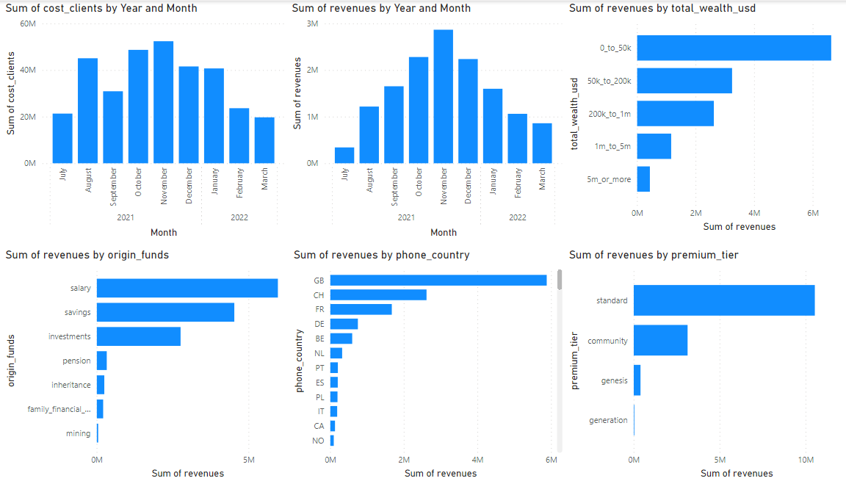
SWISSBORG – DATA ANALYST
TRANSACTION DATA - REVENUES

Slide 18
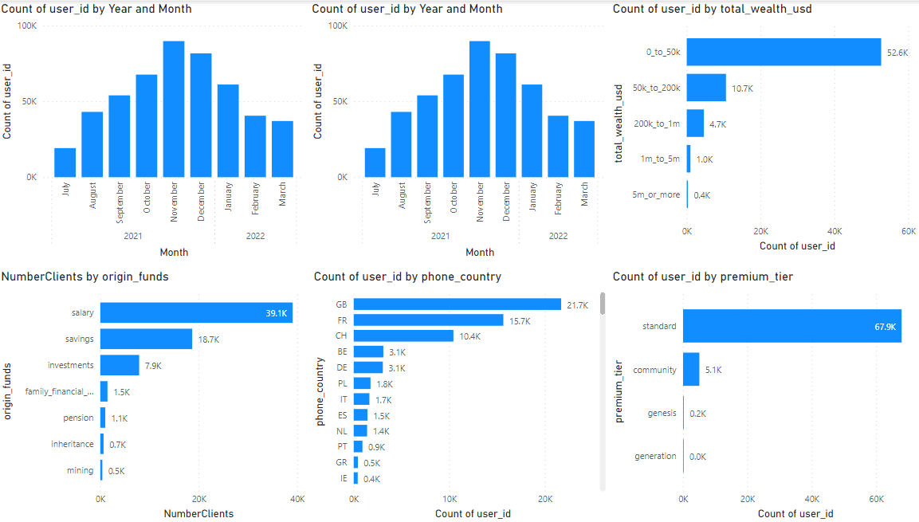
SWISSBORG – DATA ANALYST
TRANSACTION DATA – NUMBER OF USERS

Slide 19
SWISSBORG – DATA ANALYST
SQUAD I - ACQUISITION FLOW
Attraction Metrics | Number of recurring visitors | people who entered Swissborg App and decided to come back later. Mesure: Phone Verification
 | Traffic on mobile devices | where visitors come from when they land the App Google Analytics, for example, traffic sources are shown even in detail: in addition to knowing which websites your visitors came from, you even receive demographic data about them (country, language, age, etc.).
Conversion Metrics | Bounce rate | how many people left your site on the same page they entered, without visiting other pages on your site or being interested in any additional material.
 | Total conversions | the Steps: PhoneUpdated – EmailUpdated – AddressUpdated - LanguageUpdated – QuestionsUpdated – OnboardingCompleted – VerificationApprove – First Deposit

Slide 20
SWISSBORG – DATA ANALYST
SQUAD I - ACQUISITION FLOW
Conversion Metrics | Funnel conversion rate | how effective your strategy is in each part of the funnel. In doing so, you may notice that most conversion issues focus on a specific stage of the funnel, while others perform well.
Revenue Metrics | Bounce rate | on a scale of 0 to 10, how likely are your customers to recommend the App to someone. measuring the degree of satisfaction and marketing potential of your current customers.

Slide 21
SWISSBORG – DATA ANALYST
SQUAD II – PRODUCT DISCOVERY
Revenue Metrics | CAC: Customer Acquisition Cost | how much you spend to get each new customer for your product or service.
 | MRR: Monthly Recurring Revenue | this model need to have a high retention rate, that is, keep customers for as long as possible. assess the need to make changes to your pricing strategy.
 | ROI: Return on Investment | Return on Investment , which states how much the marketing efforts are producing profit for the company, is also an indispensable metric . is the main marketing metric the company should follow.
 | LTV: Lifetime Value | predicting how much money should expect to earn, on average, from each customer for as long as they buy from you. average ticket and customer abandonment rate to know how long they use your product on average.

Slide 22
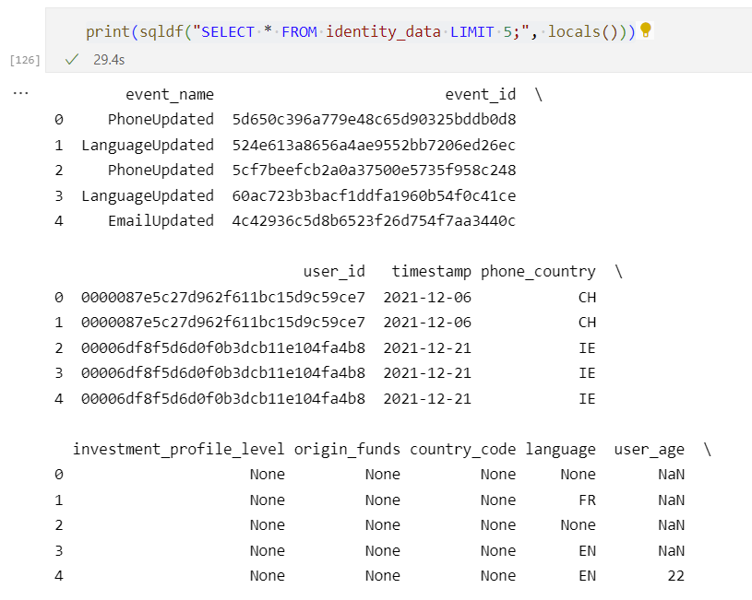
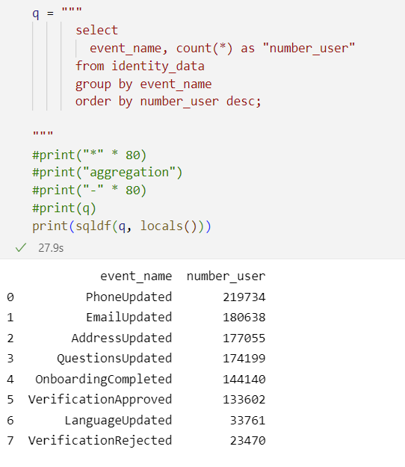
SWISSBORG – DATA ANALYST
SQL

Slide 23
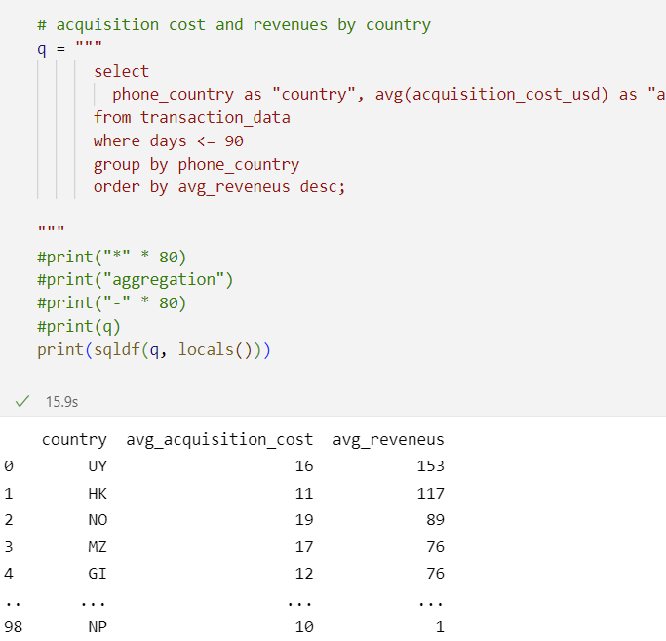
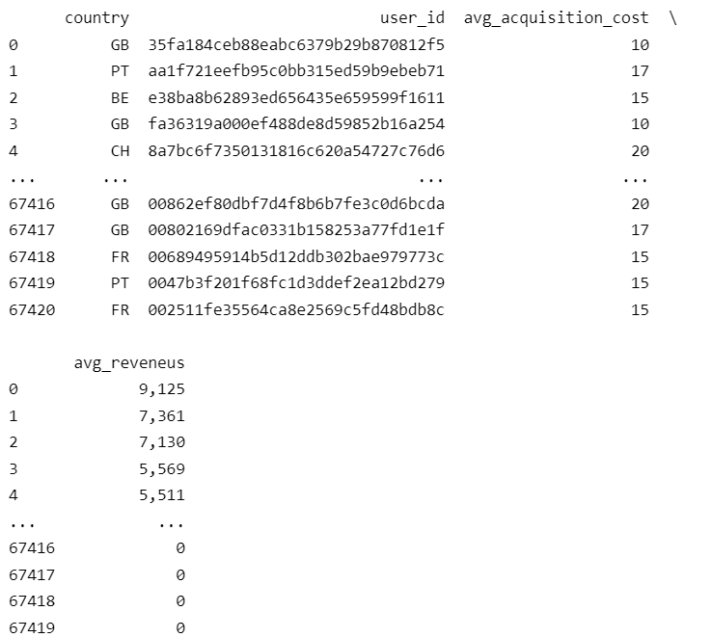
SWISSBORG – DATA ANALYST
SQL

Slide 24
SWISSBORG – DATA ANALYST
UPDATE
Correlations between some metrics: origen_funds, user_age, invest_profile, etc
More details on the graphics, as titles, etc
Difference between the date of events.
Finish the Analysis using SQL
Optimize the codes and models

Slide 25

DATA ANALYST Tech Challenger
Anderson Cruz
linkedin.com/in/anderjcruz/
linktr.ee/andercruz

